Slide 1
The Case Law of the
Constitutional Court of Ecuador on Sumak Kawsay Rights
Daniela salazar marín

Slide 2


10 facts you need to know about the
2008 Constitution
Two distinct phases of the constituent process: participation vs. accelerator
Approved by national referendum with 64% of votes
Extremely long and detailed
Receptive of international human rights treaties and instruments
In terms of rights: very progressive
In terms of institutions: some innovations
Extensive catalog of rights
Extensive catalog of guarantees for such rights
All judges are constitutional judges
All rights are justiciable

Slide 3
Sumak Kawsay (Buen Vivir)
a constitutional principle
a category of rights
a right of itself

Slide 4
Water
Food
Culture and Science
Education
Habitat and Housing
Health
Work
Social Security
Healthy Environment
Rights of Nature
Sumak Kawsay

Slide 5

Right to Water
Art. 12: The human right to water is fundamental and inalienable. Water constitutes a strategic national patrimony for public use, and it is inalienable, non-prescriptible, non-seizable, and essential for life.
Art. 314.- The State shall be responsible for the provision of public services such as drinking water and irrigation, sanitation, electricity, telecommunications, roads, port and airport infrastructure, and any other services determined by law. The State shall guarantee that public services and their provision comply with the principles of obligation, generality, uniformity, efficiency, responsibility, universality, accessibility, regularity, continuity, and quality. The State shall ensure that prices and rates for public services are equitable and shall establish their control and regulation.

Slide 6
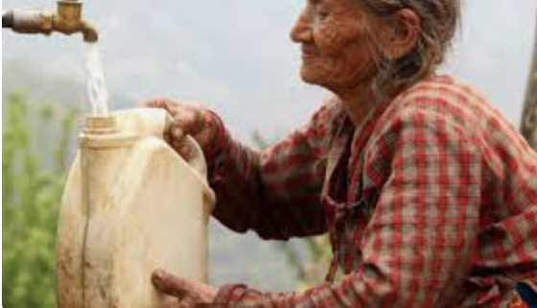
Judgment 232-15-JP/21 (Potable Water Service for Priority Attention Groups)
An elderly woman (87 years old) with a physical disability of 89%, lived with her son, who also had a physical disability of 75%.
Due to their vulnerability, they stopped paying for the potable water service
Municipal water company cut off service and removed their water meter.
Their neighbor gave them water for medicine and was sanctioned
They lived without water service between 2015 and 2020, when they were able to pay off the $115.29 they owed

Slide 7
Judgment 232-15-JP/21
Rights
Right to water includes every person’s right to access water for vital activities essential to human existence, such as food and hygiene
The State is responsible for providing potable water services
General obligation for all users to pay for water service, but need to consider the particular circumstances of individuals who are in situations of vulnerability
Proportionality: there were less restrictive alternatives, such as guaranteeing a minimum water supply instead of a total suspension of service (the law provides for a free provision of a minimum vital quantity of water for human consumption, equivalent to 200 liters per person per day), or entering into a payment agreement
The Municipal water company violated the right to water, particularly in its components of availability and economic accessibility

Slide 8
Judgment 232-15-JP/21 Reparations
Forgiveness the debt
One year of free potable water service
Payment agreement based on socioeconomic study
Protocol for providing service to users from priority attention groups in accordance with the criteria set forth in the judgment
Training plan for its personnel on the right to water and the rights of priority attention groups.
Amendment of municipal regulations to reflect the standards and criteria established in the judgment.
Analysis of the need to include woman and her son in social programs

Slide 9

Judgment 533-15-EP/23
(Right to Water in Relation to Private Parties)
Couple living in a private residential complex
The pre-association (which manages the communal areas) suspended their electricity and water, due to non-payment of fees.

Slide 10
Judgment 533-15-EP/23
Rights
Reparations
The pre-association violated the right to water.
In cases of unpaid fees, it is necessary to guarantee the minimum vital quantity of water
Any measure affecting minimum vital quantity of water must be analyzed for proportionality in light of the specific case
Public apology
Revision of internal procedures of the pre-association

Slide 11

Right to Food
Art. 13: Individuals and collectives have the right to secure and permanent access to healthy, sufficient, and nutritious food; preferably produced locally and in alignment with their diverse identities and cultural traditions. The Ecuadorian State shall promote food sovereignty.
Art. 401. Ecuador is hereby declared free of transgenic crops and seeds. Exceptionally, and only in cases of national interest duly substantiated by the Presidency of the Republic and approved by the National Assembly, genetically modified seeds and crops may be introduced. The State shall regulate, under strict biosafety standards, the use and development of modern biotechnology and its products, as well as their experimentation, use, and commercialization. The application of risky or experimental biotechnologies is prohibited.

Slide 12

Right to Food
(Art. 281): Food sovereignty constitutes a strategic objective and an obligation of the State to ensure that individuals, communities, peoples, and nationalities achieve self-sufficiency in healthy and culturally appropriate food on a permanent basis. To this end, the State shall be responsible for:
1. Promoting the production and processing of agri-food and fisheries products in small and medium-sized production units, community-based units, and the social and solidarity economy.
2. Adopting fiscal, tax, and tariff policies that protect the national agri-food and fisheries sector to avoid dependence on food imports.
3. Strengthening diversification and the introduction of ecological and organic technologies in agricultural production.
4. Promoting redistributive policies that allow farmers access to land, water, and other productive resources.
5. Establishing preferential financing mechanisms for small and medium-sized producers, facilitating their acquisition of the means of production.
6. Promote the preservation and recovery of agrobiodiversity and associated ancestral knowledge, as well as the use, conservation, and free exchange of seeds.
7. Ensure that animals intended for human consumption are healthy and raised in a healthy environment.
8. Ensure the development of appropriate scientific research and technological innovation to guarantee food sovereignty.
9. Regulate the use and development of biotechnology, as well as its experimentation, use, and commercialization, under biosafety standards.
10. Strengthen the development of producer and consumer organizations and networks, as well as food marketing and distribution networks, that promote equity between rural and urban areas.
11. Generate fair and supportive food distribution and marketing systems. Prevent monopolistic practices and any type of speculation in food products.
12. Provide food to populations that are victims of natural or man-made disasters that jeopardize access to food. Food received as international aid should not affect health or the future of locally produced food.
13. Prevent and protect the population from consuming contaminated food or food that endangers their health, or whose effects are scientifically uncertain.
14. Acquire food and raw materials for social and food programs, giving priority to associative networks of small producers.

Slide 13
Judgment 22-17-IN/22 (GMOs)
Article 56 of the law (which allowed the entry of genetically modified seeds and crops into the country for research purposes) is unconstitutional because it was approved without following the procedure established in the Constitution.
The words “certified” and “certified [plural]” in Article 37 are unconstitutional, as their exclusive use could discourage the production of traditional and peasant seeds.
The definition of “quality seed” must also recognize ancestral quality criteria, and not be limited solely to Western scientific standards.

Slide 14
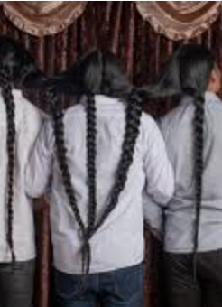
Right to Culture and Science
(Art. 21): People have the right to build and maintain their own cultural identity, to decide their belonging to one or more cultural communities and to express these choices; to aesthetic freedom; to know the historical memory of their cultures and to access their cultural patrimony; to disseminate their own cultural expressions, and to access diverse cultural expressions. Culture may not be invoked to justify actions that violate rights recognized in the Constitution.
(Art. 23): People have the right to access and participate in public spaces as areas for deliberation, cultural exchange, social cohesion, and the promotion of equality in diversity. The right to disseminate one's own cultural expressions in public spaces shall be exercised without further limitations than those established by law, subject to constitutional principles.
(Art. 24): People have the right to recreation and leisure, to engage in sports, and to enjoy free time.
(Art. 25): People have the right to enjoy the benefits and applications of scientific progress and ancestral knowledge.

Slide 15
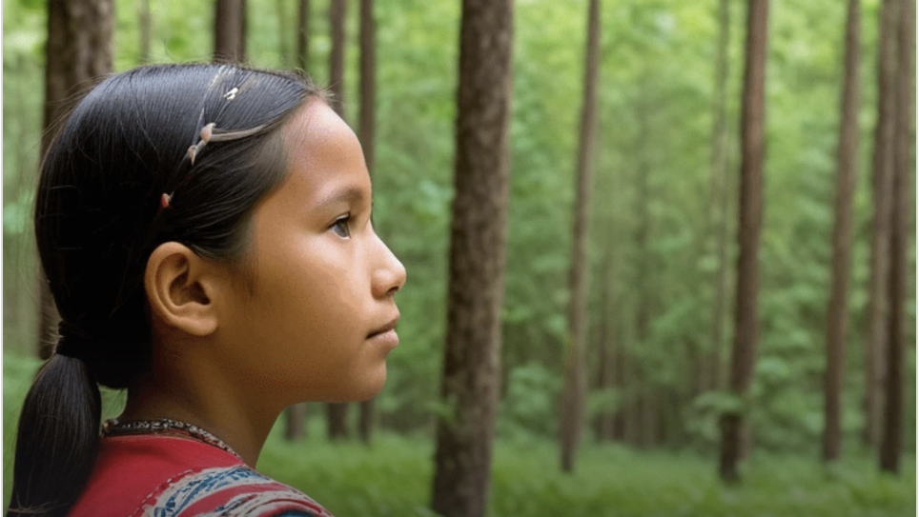
Judgment 1203-21-JP/24
(cultural identity of Awá girl)
A mother gave birth to a baby girl in her community
Due to postpartum complications, she was transferred with her newborn to the hospital
Hospital required child to be registered in order to provide medical attention
Parents decided to name her in their native Awapit language: “Sisa Mayumi (“flower and strength”)
Civil Registry refused to accept the name and girl was named “Gabriela Elizabeth,” after the two nurses who accompanied father as witnesses

Slide 16
Judgment 1203-21-JP/24
Rights
Reparations
Identity rights of children from Indigenous peoples and nationalities go beyond mere recognition of a name; they also encompass linguistic, historical, social, spiritual, and cultural elements.
Dual dimension: individual and collective.
Girl was stripped of her cultural identity
The Civil Registry and the Hospital violated the individual and collective dimensions of Sisa Mayumi’s right to identity by denying the registration of her Indigenous name and, consequently, forcing her to adopt a mestizo name with no relation to her language, community, or ancestral customs
Ratified the decision to rectify Sisa Mayumi's name
Ordered the issuance of regulation on standards related to the right to identity of children belonging to communities, peoples, and nationalities, as well as the procedural guidelines for name registration

Slide 17

Right to Education
(Art. 26): Education is a right of individuals throughout their lives and an unavoidable and non-waivable duty of the State. It is a priority area of public policy and state investment, a guarantee of equality and social inclusion, and an indispensable condition for Buen Vivir. Individuals, families, and society have the right and responsibility to participate in the educational process.

Slide 18

Judgment 1497-20-JP/21
Access to education of migrant children
Migrant girl from Venezuela denied to enrollment in 8th grade
Certificates of last 4 years of education in her country, not previous ones
Failed placement test because of points lost on questions related to Ecuadorian history and geography
By the time the mother finally managed to present the complete documentation, the registration platform was disabled.

Slide 19
Judgment 1497-20-JP/21
Rights
Reparations
Education cannot be interrupted on irrational or arbitrary grounds.
Institutions must distinguish between truly necessary requirements and those that can be reasonably addressed.
Requiring hard-to-obtain certificates from migrant families or testing for knowledge about the host country’s national context cannot be valid criteria for access to education for children in human mobility.
A policy may appear neutral but its effects on a specific group can result in indirect discrimination.
The girl's right to education in its accessibility dimension was violated when her migration status and origin became a barrier to accessing education.
Measures to ensure that students—particularly those in vulnerable situations—can access their proper educational level in a timely manner.
Education Ministry must issue guidelines for monitoring vulnerable students’ cases, including flexibility in evaluating admission requirements and reasonableness in assessing migrant students, especially avoiding content tied to the host country’s national reality.
Education Ministry must design tests tailored for migrant children.

Slide 20

Judgment 1894-10-JP/20
Prohibition of Discrimination Based on Pregnancy in Educational Settings
A woman military cadet was expelled for becoming pregnant.
The military school’s Honor Tribunal,considered pregnancy a “serious infraction” under the Military Cadet Discipline Regulations
Regulations required all officer candidates to be single and childless.

Slide 21
Judgment 1894-10-JP/20
Rights
Reparations
The right to education is fundamental to fulfilling one’s life project and must be guaranteed without discrimination.
Being pregnant, having children, or being married cannot justify expelling someone from a military career or educational institution
The accessibility and adaptability dimensions of the right to education were violated.
Upheld rulings that ordered the cadet’s reinstatement
Measures to eliminate institutional norms or practices that discriminate against pregnant women in military or educational contexts.
Training for the armed forces on non-discrimination, especially concerning pregnancy
Participatory process to evaluate and develop gender policies in the armed forces and educational institutions, including prevention of pregnancy-based discrimination

Slide 22
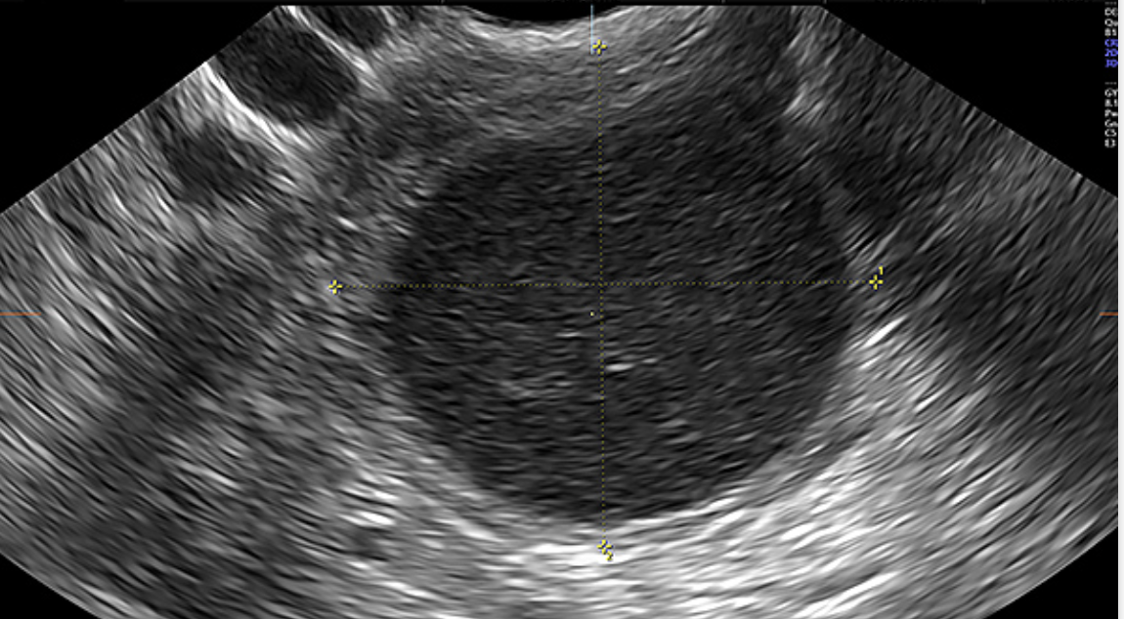
Judgment 791-21-JP/22 – Exclusion from Police Selection Process Due to Ovarian Cyst Diagnosis
A woman applicant was excluded from the recruitment and selection process to the National Police who for allegedly failing gynecological tests.
Her supposed condition was an ovarian cyst larger than 2 cm.

Slide 23
Judgment 791-21-JP/22
Rights
Reparations
Cyst is a treatable and temporary condition that does not justify exclusion
Condition is tied to natural biological processes like the menstrual cycle and ovulation
The condition disproportionately affects women
Her rights to education (in its dimensions of access and permanence) and to equality and non-discrimination were violated.
Upheld reinstatement
Revision of the extensive list of medical disqualifications in the guidelines for police applicants based on medical standards, a rights-based approach, and a gender perspective.

Slide 24

Other Important Judgments on the Right to Education
Judgment 112-20-JP/22 – Freedom of religion and education in the university context
Judgment 15-20-AN/20 – Budgetary allocations to higher education institutions
Judgment 9-20-IA/20 – Budget limitations on universities
Judgment 1016-20-JP/21 – Accessibility and inclusive higher education
Judgment 12-11-IN/20 – University autonomy

Slide 25

Right to Habitat and Housing
(Art. 30): People have the right to a safe and healthy habitat, and to adequate and dignified housing, regardless of their social or economic status.
(Art. 31): People have the right to the full enjoyment of the city and its public spaces, based on the principles of sustainability, social justice, respect for diverse urban cultures, and the balance between urban and rural environments. The exercise of the right to the city is based on democratic management, the social and environmental function of property and the city, and the full exercise of citizenship.

Slide 26
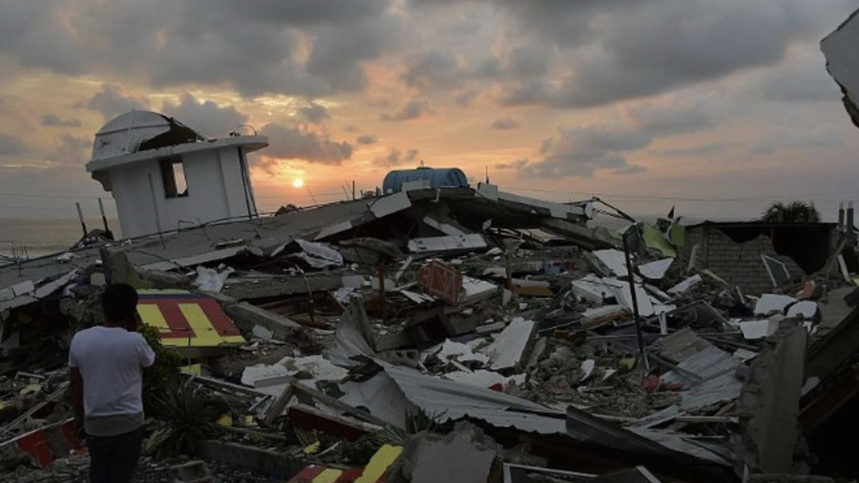
Judgment 515-20-JP/21
Housing for earthquake victims
7.8 magnitude earthquake struck Manabí in 2016.
Structural damage forced affected populations to abandon their homes.
80,000 people were displaced , 13,962 affected buildings.
In Pedernales 70–80% of structures were destroyed.
Ministry of Housing issued a program for "Housing Recovery for Victims of the April 16, 2016 Earthquake," which established four forms of financial aid:
  (a) construction on state-developed land,
  (b) rebuilding on personal land,
  (c) repairs to recoverable homes, or
  (d) purchase or construction of new homes.
Victims had to apply using a government form to qualify.
122 people filed a constitutional complaint stating their right to adequate housing violated by the Ministry’s failure to provide technical, technological, and bureaucratic support to register them in the system.

Slide 27
Judgment 515-20-JP/21
Rights
Reparations
The State has two main obligations:
  prevention (through pre-disaster public policies)
  mitigation/recovery (through post-disaster policies).
The State must implement housing programs subject to budgetary constraints and the principle of progressiveness
Court may not assess whether post-disaster policies are correct, but Ministry failed to justify the denial of access
Ministry officials discouraged the claimants to apply
The Ministry’s failure to facilitate registration in its own system barred several claimants from accessing the aid they were entitled to, thus violating their right to adequate housing.
Ministry of Housing must conduct a new and complete census
Ministry must provide detailed follow-up to each claimant to determine case by case whether they qualify for housing recovery aid.

Slide 28
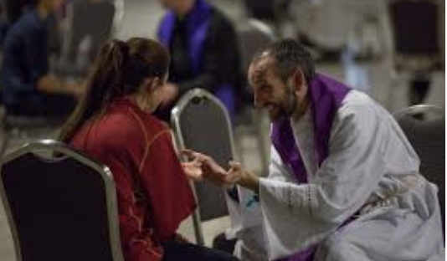
Judgment 832-20-JP/21 – Right to Housing and Property of Older Adults Violated by Private Actors
78 year-old woman with a 54% physical disability, multiple illnesses including severe vision loss, lived alone in extreme poverty in a property she acquired in 1964. She had no income and survived on alms, neighbors’ help, and a $50 monthly government subsidy.
A devout Catholic, she confessed to the priest she needed a caregiver due to her declining health.
Woman was deceived by the priest and a notary to sell her home in exchange for promised care.
She was left in a situation of homelessness
As a result of his abuse of religious power, the woman ended up living in a makeshift shelter that lacked adequate infrastructure, lacked basic services, and did not meet the concept of adequate housing.

Slide 29
Judgment 832-20-JP/21
Rights
Reparations
Responsibility of notary (public officer) and priest (subordination).
Priest violated right to housing.
  Private actors, under specific conditions, can be held accountable for violating rights to housing and dignity.
Notary violated rights to priority attention, access to quality public services, and property.
  Standards on the right of persons belonging to priority care groups—such as older adults—to access quality public services.
Public Defender’ must pursue ordinary civil or criminal judicial proceedings aimed at recovering the property.
Ministry of Housing to ensure access to housing vouchers programs.
Priest and Judiciary Council to pay reparations (in equity) for pain and suffering.
Judicial Council must adapt its regulations and train the country's notaries in the standards established in the judgement.
Human rights training for priests.
Public apologies.

Slide 30

Right to Health
(Art. 32): Health is a right guaranteed by the State, whose fulfillment is linked to the exercise of other rights, including the rights to water, food, education, physical culture, work, social security, healthy environments, and others that sustain Buen Vivir.
The State shall guarantee this right through economic, social, cultural, educational, and environmental policies, and through permanent, timely, and non-exclusionary access to programs, actions, and services for the promotion and comprehensive provision of health care, including sexual and reproductive health.
The provision of health services shall be governed by the principles of equity, universality, solidarity, interculturality, quality, efficiency, effectiveness, precaution, and bioethics, with a gender and generational perspective.

Slide 31

Judgment 904-12-JP/19
Reproductive health, obstetric violence
27 years old pregnant woman expecting her fourth child was in labor.
Sought care at a hospital within the social security network.
Despite her intense pain, she was denied medical care.
She screamed in pain and begged for help. She recalls feeling treated like an animal.
She was left alone in an operating room. Baby was born without medical assistance, and the woman lost so much blood that she passed out.
Later, against her will, she was transferred to another facility after several others refused to receive her.
This produced long-term health complications that could have been avoided.
The hospital’s argument was that her employer was behind on social security contributions—a justification that national law prohibits as a basis for denying emergency medical care. Also, it was later proved false.

Slide 32
Judgment 904-12-JP/19
Rights
Reparations
Declared the existence of obstetric violence
Hospital’s refusal to provide care due to alleged non-payment violated the right to health (availability, accessibility, acceptability, and quality).
The right of pregnant women and newborns to priority care means they must be given precedence in heath service provision.
Hospital also violated rights to priority care and social security.
Monetary compensation for expenses incurred by the woman
Compensation in equity for non-material damage;
Public apology;
That the social security institute and the Ministry of Public Health develop a “Comprehensive Care Guide for Pregnant Women and Prevention of Obstetric Violence” and a “National Technical Review Plan” to ensure that public and private health facilities are adequately equipped to care for pregnant women before, during, and after childbirth, and to manage obstetric emergencies like uterine and postpartum hemorrhage.

Slide 33

Judgment 983-18-JP/21
Right to health, migratory status
Family migrated from Colombia to Ecuador. Recognized as refugees.
Pregnant, Afro-Colombian refugee woman sought pre-natal medical care.
Pregnancy was flagged as high-risk due to blood incompatibility with the fetus, but she was never properly informed of the implications.
She was not referred on time to a center equipped to manage the condition.
After birth, referral system denied them care because they were Colombian, they were told to return to Colombia for treatment.
Newborn died after a few days due to lack of medical care.

Slide 34
Judgment 983-18-JP/21
Rights
Reparations
Violation of the newborn’s rights to life and health, the best interests of the child,
Violation of the right to equality and non-discrimination based on migratory status
Violation of the the principle of non-refoulement.
Compensatory damages for material harm.
Compensation in equity for non-material harm.
Availability of psychological care for the parents and siblings in their place of residence.
Public apology.
Development of a Protocol for the Care of Pregnant Women and Newborns, especially those in situations of human mobility;
A national report on the health system’s capacity to care for pregnant women, newborns, children, and adolescents, including safe and timely medical transfers. Use of the national report to guide the Ministry’s annual budget.
A short- and medium-term plan to ensure adequate medical supplies and transfusion treatments across all provinces.
Implementation of a national-level health information system to facilitate patient referrals.
Training plan for medical staff in border provinces on the rights of migrants and refugees.

Slide 35
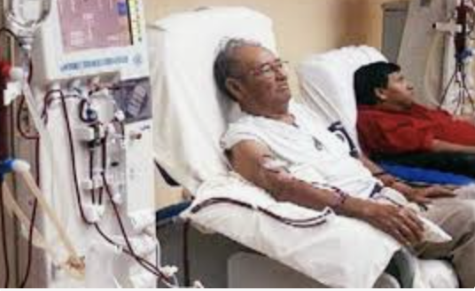
Judgment 16-16-JC/20
Right to health of people with chronic kidney disease
Ministry of Finance stopped paying private health centers offering dialysis treatment for patients referred from public health system
Ministry of Health filed a request for precautionary measures to protect dialysis patients whose treatment was threatened by private centers due to delayed payments from the Ministry of Finance.

Slide 36
Judgment 16-16-JC/20
Rights
Precautionary measures
The availability and accessibility of dialysis as a structural threat to health.
Structural situation that requires a comprehensive public health policy from the Ministry of Health and a financing plan from the Ministry of Finance.
Parameters to ensure treatment
Health services cannot be suspended
Ministry of Finance has duty to pay providers on time
A joint program by the Ministries of Health and Finance to pay outstanding debts to dialysis providers;
Strengthening of the public policy on chronic kidney disease prevention and treatment;
Permanent coordination mechanisms for timely payments to private dialysis centers.

Slide 37

Judgment 2951-17-EP/21 right to health, private hospital
A family planned their child’s birth as a “humanized delivery” in a private facility
The risks of preterm birth were not disclosed.
The doctor, who owned the clinic, posed as an obstetric surgeon without a formal specialization.
The baby was delivered at 35 weeks via emergency C-section.
The newborn experienced respiratory distress and was given fentanyl for intubation without informed parental consent.
Newborn was eventually transferred to a hospital with an ICU.
Child now has a severe disability. The parents attribute this condition to inadequate care during child birth; the clinic blames a genetic condition.

Slide 38
Judgment 2951-17-EP/21
Rights
Reparations
Violations of the newborn’s right to health, specifically the right to access quality public healthcare
Violation of the right to informed consent.
Public apology from the doctor;
Equitable compensation for non-material damages;
Mandatory training by the Ministry of Health for medical staff on informed consent and the doctor-patient relationship.

Slide 39
Judgment 679-18-JP/20 Access to medicine for people with catastrophic illnesses
Facts:
complex case addressing the inability of people with catastrophic or high-complexity diseases to access essential medications—even after seeking judicial protection
Rights
Reparations
The Court identified a budgetary regression in funding for health, medications, and health personnel.
The Court developed the content of patients’ rights to:
  Information,
  Informed consent,
  Access to quality, safe, and effective medications
The Court established indicators for guiding public policy on medication access,

Slide 40

Right to Work
(Art. 33): Work is a right and a social duty, and an economic right, a source of personal fulfillment and the foundation of the economy. The State shall guarantee workers full respect for their dignity, a decent life, fair wages and compensation, and the performance of healthy and freely chosen or accepted work.

Slide 41
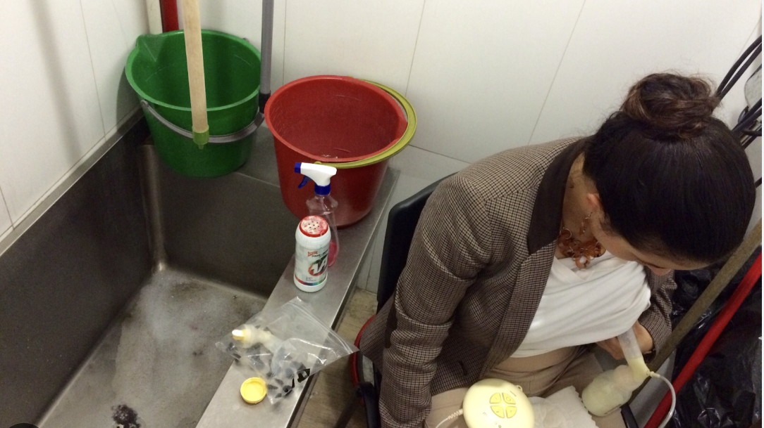
Judgment 3-19-JP/20 Pregnant and Lactating Women’s Right to Care
19 cases involving public employees who were pregnant, breastfeeding, or on maternity leave.
Working women were inquired about marital or pregnancy plans.
Requests for pregnancy tests at work.
Request for disclosure of medical records, and use of this information to restrict employment.
Women breastfed or pumped milk in workplace bathrooms during lunch breaks.

Slide 42
Judgment 3-19-JP/20
Rights
Reparations
Right to work without discrimination
Right to make decisions on sexual and reproductive health;
Right to privacy and protection from arbitrary interference;
Right to care
Special protections for pregnant women;
Right to breastfeed.
To promote shared caregiving and reduce gender gaps, the Court ordered the National Assembly to legislate on:
  Expanding paternity leave;
  Leave for adoptive parents;
  Measures to ensure that leave is actually used for caregiving;
  Consequences for failure to fulfill caregiving responsibilities.
Measures to ensure access to information on breastfeeding;
Measures to support for breastfeeding under dignified conditions: ordered all public institutions to create suitable, dedicated spaces for breastfeeding and milk expression and storage.

Slide 43

Right to Social Securty
Art. 34: The right to social security is an inalienable right of all individuals and a fundamental duty and responsibility of the State. Social security shall be governed by the principles of solidarity, mandatory participation, universality, equity, efficiency, subsidiarity, sufficiency, transparency, and participation, to address both individual and collective needs. The State shall guarantee and ensure the full exercise of the right to social security, including for people who perform unpaid work in the home, subsistence activities in the countryside, all forms of self-employment, and those who are unemployed.
Art. 371.- Social security benefits shall be financed by contributions from insured persons in a dependent relationship and their employers; by contributions from independent insured persons; by voluntary contributions from Ecuadorians domiciled abroad; and by contributions from the State. State resources allocated for mandatory universal insurance shall be included annually in the General State Budget and shall be transferred in a timely manner. Social security cash benefits shall not be subject to transfer, seizure, or retention, except in cases of alimony owed by law or obligations contracted in favor of the insurance institution, and shall be exempt from tax.

Slide 44
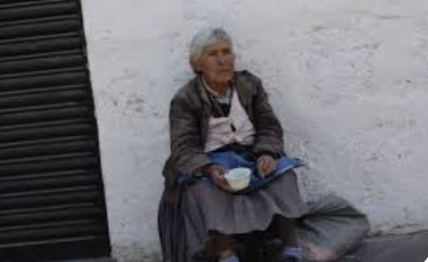
Judgment 889-20-JP/21 Right to survivor’s pension
An elderly woman with a 61% physical disability, lived in poverty.
Her only income was an orphan’s survivor pension (around $200). Children of any age who are unable to work, single, widowed or divorced, and who were dependent on the deceased are entitled to the survivor’s pension, as part of the right to social security.
The woman faced health issues, and in order to buy her medication, she stopped paying her telephone bill.
She was informed of an $80 debt. She began saving to fulfill her obligation, but the state phone company cut her telephone service,
She assumed that was the end of it. However, the phone company initiated a a debt enforcement proceeding to collect the telephone service debt.
As a part of this procedure, her bank account was closed, preventing her from accessing her survivor’s pension.
First, she was ordered her to pay $157.93 within three days (debt plus interest, legal fees, charges, court costs). As she could not pay, debt increased, amounting $460.
The phone company did not accept partial payments.
During the account freeze, she had to rely on charity and go into debt to obtain food and medicine.
“Every day I prayed to God for health so I could save the money and pay CNT what they asked. Because of a phone line, I had to go without medicine and food, I ended up paying nearly three times the original debt and even went into debt.”

Slide 45
Judgment 889-20-JP/21
Rights
Reparations
Constitutional prohibition on the seizure or withholding of social security benefits.
Debt enforcement proceedings in relation to the rights of people in vulnerable situations
Rights to priority and specialized care, to the survivor’s pension, to quality and efficient public services, and to receive accurate and adequate information about the content and nature of the debt.
Company must reimburse the woman the amount she could not access during the seizure,
Company must pay compensation for intangible damages, distress, and suffering caused by the withholding of her survivor’s pension during the months the account was frozen;
Public apology
Company must take the necessary steps to comply with the constitutional prohibition on seizing social security benefits.
Company must establish internal protocols to ensure that, before imposing precautionary measures in enforcement proceedings, it identifies whether debtors belong to priority attention groups and receive retirement or other social security pensions
Similar jurisprudence
105-10-JP/21
725-15-JP/23
145-17-EP/23

Slide 46

Judgment 2936-18-EP/21
Social Security for Artisans
A retired woman received pensions from social security.
She was a seamstress affiliated under the social security scheme for artisans. (self-employed craftspersons).
She was diagnosed with breast cancer.
She received medical care through social security.
Before receiving each treatment she was required to pay outstanding contributions.
The Social Security Institute (IESS) later issued ten “glosas” against her for employer liability, seized funds from her account, and ordered seizures for $14,465.25 plus interest and legal fees for failing to pay contributions during her chemotherapy.
This caused severe anxiety and emotional distress, especially due to fear that her home would be seized.

Slide 47
Judgment 2936-18-EP/21
Social Security for Artisans
“...all this time I’ve been living a nightmare. I’m afraid they’ll take the only thing I have—my house, built with my husband. I don’t have accounts, I have nothing, just that one little house. They’re charging me something so unfair… I go from doctor to doctor because fear has weakened me, the cancer cells are affecting my colon, my spine, my knees—my nerves are shattered from the stress of these proceedings.”

Slide 48
Judgment 2936-18-EP/21
Rights
Reparations
Hospital violated her right to health by refusing to provide medical care until she paid her overdue contributions.
Employer liability is a financial penalty imposed on employers, covering the full cost of the benefit plus a 10% surcharge. Artisans are self-employed workers and cannot be considered employers of themselves.
By requiring the artisan to pay back contributions and also cover the costs of her own medical care—a benefit protected by the right to social security—the social security institute violated her right to social security.
The Constitution prohibites the seizure or withholding of a pension. By seizing the entirety of her disability and survivor’s pensions, the social security institute violated her right to a dignified life.
Nullified all glosas as well as all payment orders, seizures, and credit titles
Social Security Institute must
  return all seized funds to her bank account, including interest, fees, or collection costs;
  Pay her $7,694.39 in material compensation equivalent to the amount of her missed pension payments;
  Pay amount in equity in recognition of the anguish and suffering caused
  Issue public apologies were ordered,
  Review of internal hospital regulations and procedures to ensure eligible patients are not denied care due to unpaid contributions;
  Internal investigation to establish responsibilities.

Slide 49
Other Important Judgments on the Right to Social security
1504-19-JP/21 The Court protected the rights of a former member of the Ecuadorian Navy who was not granted a subsistence pension after being discharged due to a disability caused by a gunshot to the head while on active duty.
49-20-IN/25: Unconstitutionality of Ministry of Labor resolutions and various provisions of the Humanitarian Support Law (LOAH) related to the COVID-19 crisis.
105-21-IN/25: Unconstitutionality of Articles 1 and 2 of the Reform Law on Social Security, the Armed Forces Social Security Law, and the National Police Social Security Law.
57-23-IN/24: Unconstitutionality of Article 11 of the Law on Defense and Development of Self-Employed Workers and Small Retailers, which sets a special social security regime for these workers.
18-17-IN/23: Unconstitutionality of Article 19 of Resolution C.D. 100 of the IESS Board, denying survivor’s pension to spouses legally separated due to fault or separated for more than five years.
56-21-IN/23: Unconstitutionality of the Special Retirement Law for Cement Industry Workers.
79-16-IN/22: Unconstitutionality of Resolution C.D. 476 on calculating employer retirement pensions.
83-16-IN/21: Unconstitutionality of norms affecting the financing and sustainability of Armed Forces and National Police social security systems.
73-09-IN/21: Conditional constitutionality of pension reductions for Central Bank officials.
26-18-IN/20: Unconstitutionality of mandatory resignation buyouts with compensation.
17-14-IN/20: Constitutional review of rules on closed complementary pension funds.
23-18-IN/19: Unconstitutionality of pension withholdings for retirees.
49-16-IN/19: Conditional constitutionality of Resolution C.D. 300’s provision reducing State contribution to old-age pensions.
28-12-IN/19: Constitutionality of Executive Decrees amending the Armed Forces Social Security Law regulations.

Slide 50

Right to a Healty Environment
Art. 14: The right of the population to live in a healthy and ecologically balanced environment, which guarantees sustainability and Buen Vivir (Sumak Kawsay), is recognized. The preservation of the environment, conservation of ecosystems, biodiversity, and the integrity of the country’s genetic patrimony, as well as the prevention of environmental damage and the restoration of degraded natural spaces, are declared matters of public interest.
Art. 66.27: People have the right to live in a healthy, ecologically balanced, and pollution-free environment, in harmony with nature.

Slide 51

Rights of Nature
Art. 10: Individuals, communities, peoples, nationalities, and collectives are holders and shall enjoy the rights guaranteed in the Constitution and in international instruments. Nature shall be a subject of the rights recognized to it by the Constitution.
Art. 71: Nature, or Pacha Mama, where life is reproduced and realized, has the right to have its existence fully respected, as well as the maintenance and regeneration of its life cycles, structure, functions, and evolutionary processes. Any person, community, people, or nationality may demand that the public authorities enforce the rights of nature. For the application and interpretation of these rights, the principles established in the Constitution shall be observed, where applicable. The State shall encourage natural and legal persons, and collectives, to protect nature and shall promote respect for all elements that form an ecosystem.
Arts. 395 - 415

Slide 52
Through the rights to a healty environment and Nature’s Rights, the Court has protected
The rights of indigenous communities
The rights of mangroves
The rights of a protected forest
The rights of rivers
The rights of a woolly monkey

Slide 53
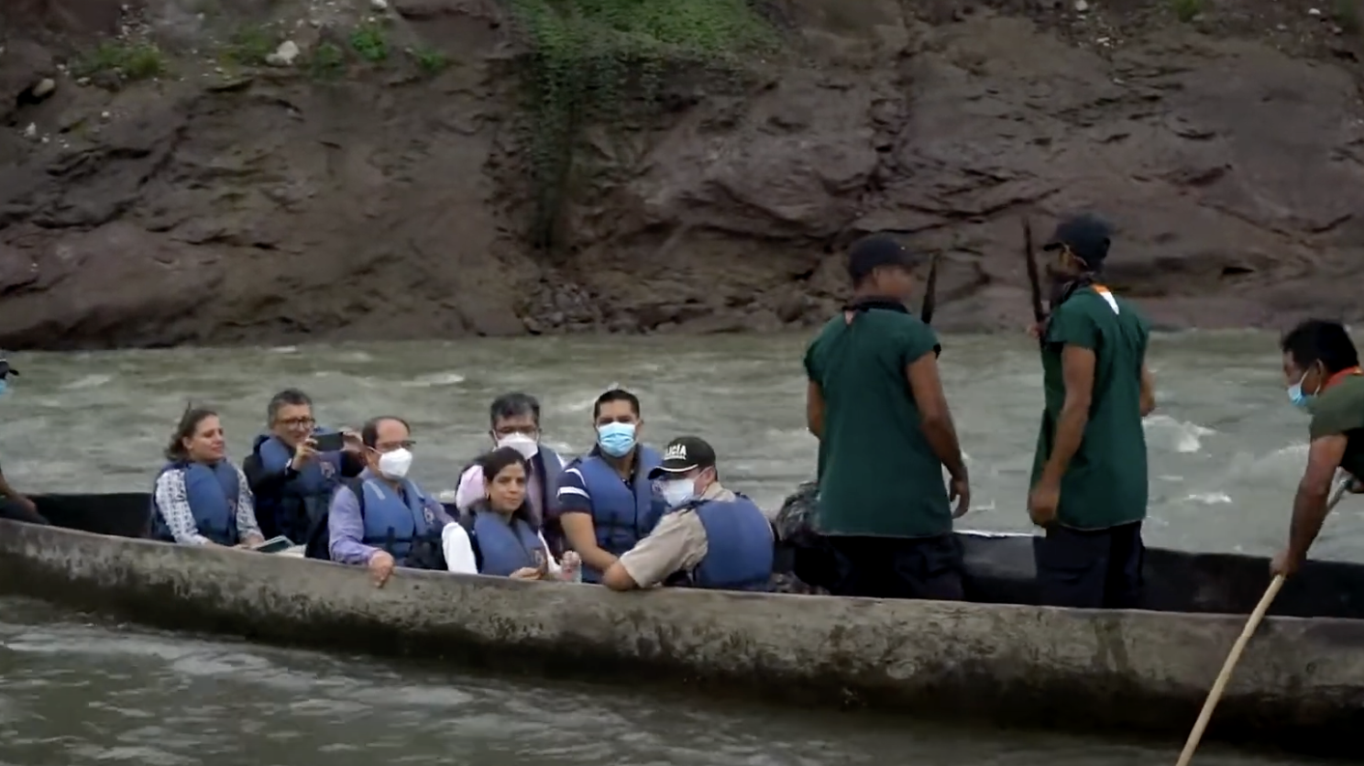
Judgment 273-19-JP/22 Right to prior consultation of the A’I Cofán of Sinangoe
The ancestral community of Sinangoe, consists of 37 families and about 1,093 individuals who rely on fishing, hunting, farming, and caretaking of the land.
The Aguarico River is “the source of life” for the Cofán. It is deemed sacred and part of their ancestral territory.
The Ministry of Energy and Non-Renewable Natural Resources authorized mining concessions
  20 active mining concessions for small- and medium-scale gold mining—totaling 19,556 hectares along river were granted
  32 additional concessions in process
Concessions were granted without conducting prior consultation, arguing that mining was taking place on the right bank of the Aguarico River, while illegal mining occurred on the left bank.

Slide 54
Judgment 273-19-JP/22
Territory is fundamental for Indigenous peoples.
Any extractive projects with potential impacts in their territory must undergo prior consultation to allow real participation.
The duty to consult applies not only to projects within their territory, but also to those outside their territory that may directly affect them (environmentally or culturally) due to proximity.
Rivers, forests, and other elements of nature were also at risk. These elements are of vital importance not only to Sinangoe, but to the biodiversity of Ecuador and the world. These elements are interconnected, and their sustainability affects the rights of all people and of nature itself.
The Court identified violations to the right to prior consultation, the rights of nature, the right to a healthy and balanced environment, the right to water, the right to culture, and territory.
The Court upheld the reparations ordered by lower courts which nullified the mining concessions.

Slide 55

Judgment 22-18-IN/21
Mangroves as Rights-Holders
The inclusion in the law of the term "other productive activities," to be defined by regulation, indefinitely endangered the mangrove ecosystem.
By declaring the unconstitutionality of several provisions of the Organic Environmental Code and its regulations, the Court recognized that fragile mangrove ecosystems hold rights as part of nature.
Mangroves have the right "to have their existence fully respected, as well as the maintenance and regeneration of their life cycles, structure, functions, and evolutionary processes."

Slide 56

Judgment 1149-19-JP/21 – Los Cedros Protected Forest as a Rights-Holder
Los Cedros is an ecosystem where two highly biodiverse regions converge: the Tropical Andes and the Chocó Bioregion.
Los Cedros hosts endemic species; contains a high number of threatened species; includes unique and rare species; it holds rich and unknown genetic heritage; functions as a biodiversity corridor.
The administrative decisions related that allowed mining activity within the Los Cedros Protected Forest were challenged.
The Court took into consideration species extinction; ecosystem destruction; the principles of prevention and precaution.
The Court held that the Ministry of the Environment violated the rights of nature of the Los Cedros Protected Forest, the right to water, and the right of the communities located in the project’s area of influence to be consulted about decisions or authorizations that could affect the environment.
The Court ordered the annulment of the concessions and prohibited any mining activity in the area of the Los Cedros Protected Forest.
The Court also ordered the Ministry of the Environment to amend its sub-legal regulations regarding the issuance of environmental registrations, environmental licenses, and water use for extractive activities.

Slide 57
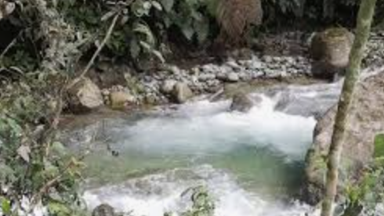
Judgment 1185-20-JP/21
Aquepi River as a Rights-Holder
The National Water Secretariat and the provincial autonomous government authorized the use of rhe Aquepi river’s flow for an irrigation project in favor of the provincial government.
The Court considered the structure, functions, and evolutionary processes of the river, and its importance for both the local population and the ecosystem.
The adminstrative decision violated:
  the Aquepi River ‘s right to preserve its ecological flow,
  The right of the residents of the Julio Moreno Espinosa and San Vicente de Aquepi communities to be consulted about the implementation of public works projects.
As part of the reparations, the Court ordered:
  an impartial technical audit of the ongoing projects affecting the river, with the participation of the affected communities;
  comprehensive studies to determine the river’s average flow, structure, functions, life cycle, and ecosystem; measures for the creation of a water protection area for the river; and
  a public apology to the residents of Julio Moreno Espinosa and San Vicente de Aquepi.

Slide 58
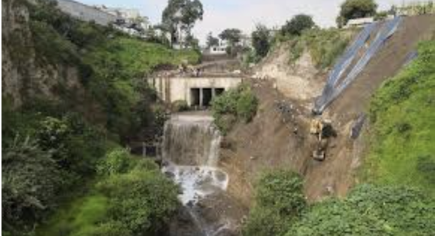
Judgment 2167-21-EP/22
Monjas River as a Rights-Holder
The Monjas River is located in the northern part of Quito. The river is polluted mainly due to domestic and industrial wastewater.
The Municipality of Quito discharges sewage and stormwater beyond the Monjas River’s capacity. It also pollutes the water above permissible levels.
The ongoing, unplanned urban expansion along the riverbanks has significantly increased the river’s flow, placing pressure on the ecosystem and its resources, and causing slope instability.
The progressive erosion of the ravine’s upper edge has also put nearby houses at risk of collapse, including a private property known as “Casa Hacienda Carcelén,” part of Quito’s heritage estate inventory, which is at high risk of collapsing.

Slide 59
Judgment 2167-21-EP/22
Rights
Reparations
The Monjas River is a subject and rights-holder.
The Court found a violation of its right “to have its existence fully respected, as well as the maintenance and regeneration of its life cycles, structure, functions, and evolutionary processes”
The Court found a violation of people's rights to live in a healthy and ecologically balanced environment, linked to the rights to safe housing, water, sustainable development, the city, and cultural heritage.
i) the execution of works to stabilize the river’s course and protect the heritage estate;
ii) the formulation and implementation of a public policy embodied in a Complementary Plan for the Monjas River, which must include short-, medium-, and long-term measures to stabilize, restore, decontaminate, and reestablish the ecological balance of the Monjas River and its tributaries;
iii) the issuance of a municipal ordinance for the restoration and integrated treatment of the Monjas River basin and other similar basins in Quito.

Slide 60

Judgment 253-20-JH/22 – “Estrellita” the Woolly Monkey as a Rights-Holder
A woolly monkey named Estrellita, lived for 18 years in a human household. This species is endangered.
Upon receiving a report that wild fauna was being kept in a home, authorities confiscated Estrellita and placed her in the custody of a zoo, where she was confined to a cage.
A woman who identified herself as the “mother and caretaker of Estrellita,” said that her “home was raided and Estrellita was abruptly removed from the environment that had been her home for her entire life.”
She filed an habeas corpus action to regain custody of the monkey, and to obtain a license for wildlife custody.
Estrellita died in the zoo before the case was resolved. Reports found that her death was not due to natural causes typical of the species, but rather to malnutrition, poor physical condition from an inadequate environment, high stress levels, among other factors.
The protection of nature as a rights-holder can include the protection of a wild animal, such as a woolly monkey, since it entails protecting both nature and its components.
The Court found a violation of the rights of nature, primarily due to the events leading to Estrellita’s death.
As reparations, The Ministry of the Environment, with the oversight of the Ombudsman’s Office, must
  develop regulations to guide their actions in protecting wild animals;
  issue rules establishing minimum conditions for animal caregivers;
The Ombudsman’s Office, in a participatory process supported by technical organizations, nyust:
  Draft a bill on animal rights, consistent with the judgment, for debate and approval by the National Assembly.

Slide 61
Other Relevant Decisions on the Rights of Nature and the Right to a Healthy Environment
20-12-IN/20 – Unconstitutionality of Ministerial Agreement No. 080 issued by the Ministry of the Environment
32-17-IN/21 – Unconstitutionality of Articles 86 and 136 of the Environmental Regulation on Mining Activities

Slide 62
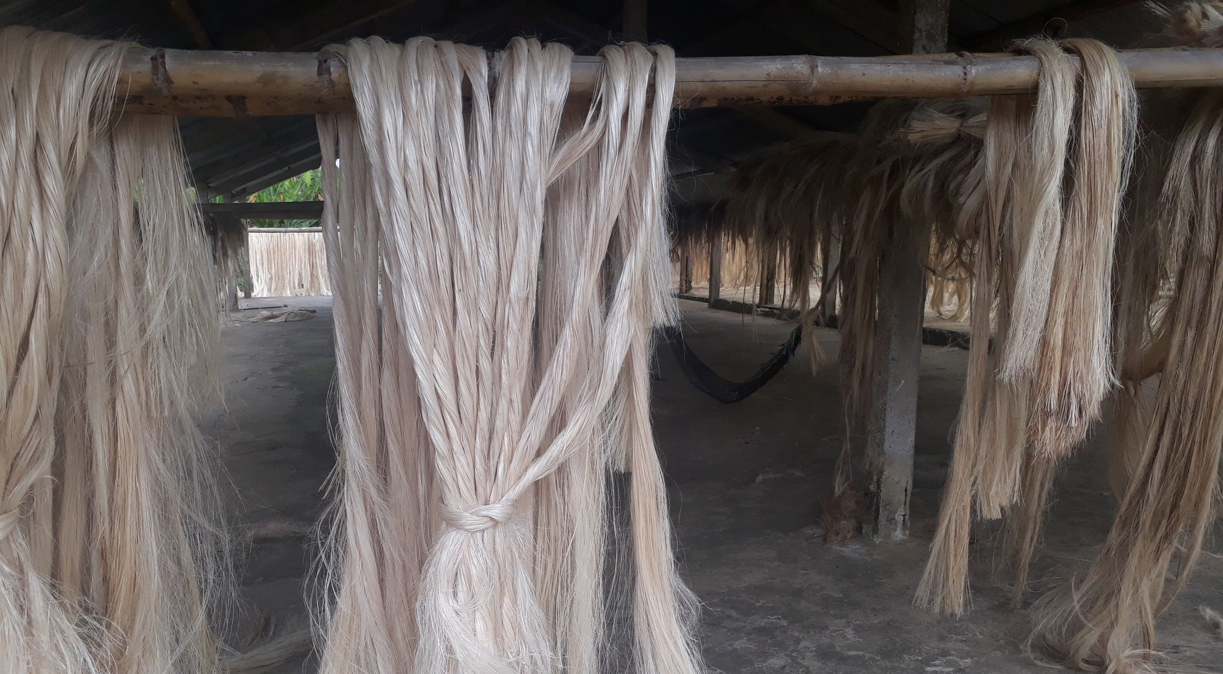
Judgment 1072-21-JP/24
Modern Slavery in Furukawa
For over five decades, until 2019, Furukawa maintained in its plantations a practice analogous to slavery, known as servidumbre de la gleba (bonded labor or serfdom).
This system involved exploiting individuals in conditions of extreme vulnerability, forcing them to live in camps within the plantations and harvest abacá for Furukawa’s benefit over several generations, without any possibility of changing their condition.
The people who lived on Furukawa’s plantations were extremely poor, mostly of Afro-descendant origin.
The abacá workers (abacaleros) lacked professional degrees and most had not completed primary or secondary education. Many of them were illiterate or functionally illiterate.
Several abacaleros living on the plantations until 2019 did not have national ID cards, which prevented them from accessing other job opportunities, and rights.

Slide 63
Judgment 1072-21-JP/24
Modern Slavery in Furukawa
The camps inside Furukawa’s plantations lacked basic sanitary facilities: there was no potable water, electricity, proper ventilation, or waste treatment systems.
The gates remained closed, and the entry of vehicles was prohibited. The only way for abacaleros to leave was on foot.
The plantations were located far from health centers and schools.
No risk prevention or harm mitigation measures were adopted regarding the cultivation of abacá.
When an abacalero was injured at work, other abacaleros would provide care. If medical attention was needed, the injured person was carried in a hammock by others to the nearest health center.
No medical care was provided to pregnant women.
Childbirth occurred on the plantations, sometimes with a midwife present, or, if necessary, women were carried in a hammock to the nearest health center, assisted by other abacaleros.
Women were exposed to sexual violence both within the plantations (by hierarchical superiors) and during long walks to populated areas.

Slide 64
Judgment 1072-21-JP/24
Modern Slavery in Furukawa
Abacá is a plant similar to the banana that grows in tropical climates. Its fiber is used in the textile and paper industries.
The cultivation of abacá poses health risks.
Many of the victims suffered from respiratory problems, muscle and joint pain, vision and hearing loss, and amputated limbs (particularly leg amputations caused by accidents with defibrillator machines).
They also suffered cuts from machetes and knives and snake bites.

Slide 65
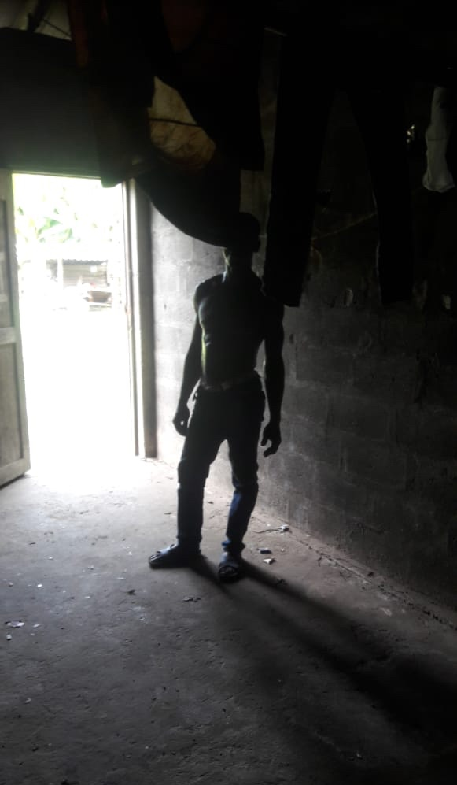
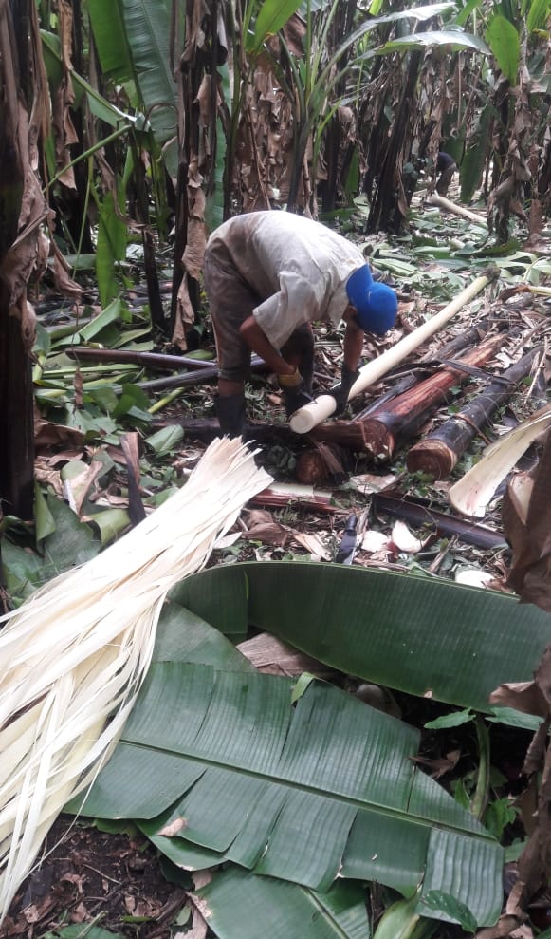
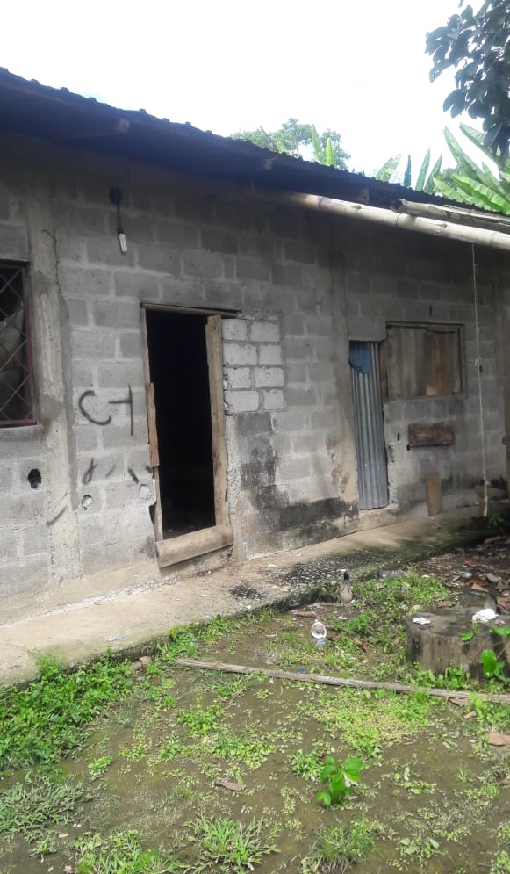

Slide 66
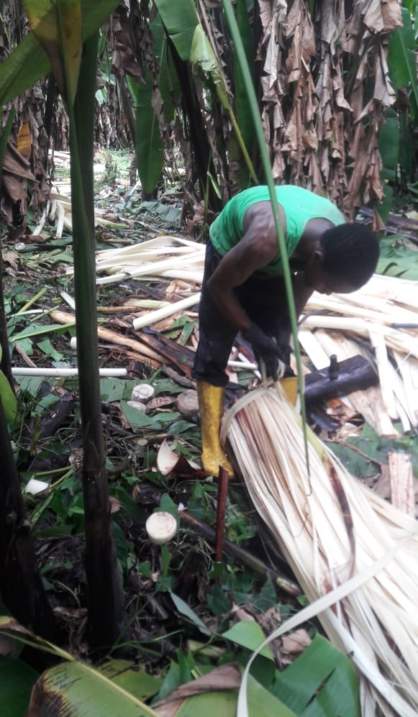
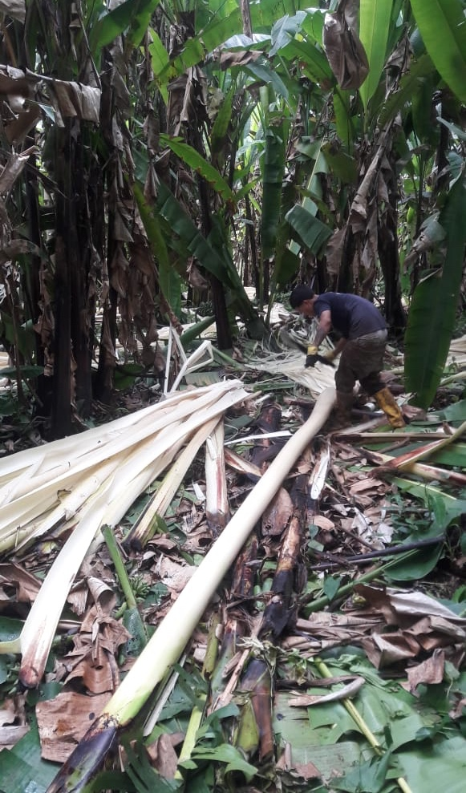
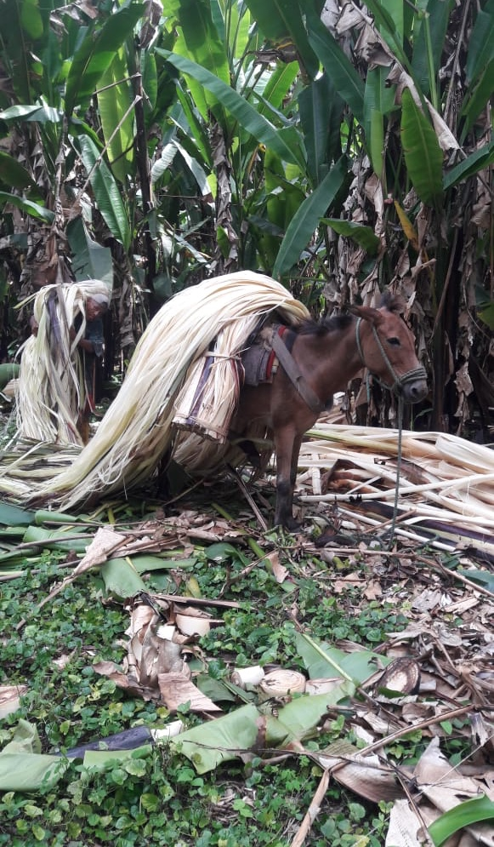

Slide 67
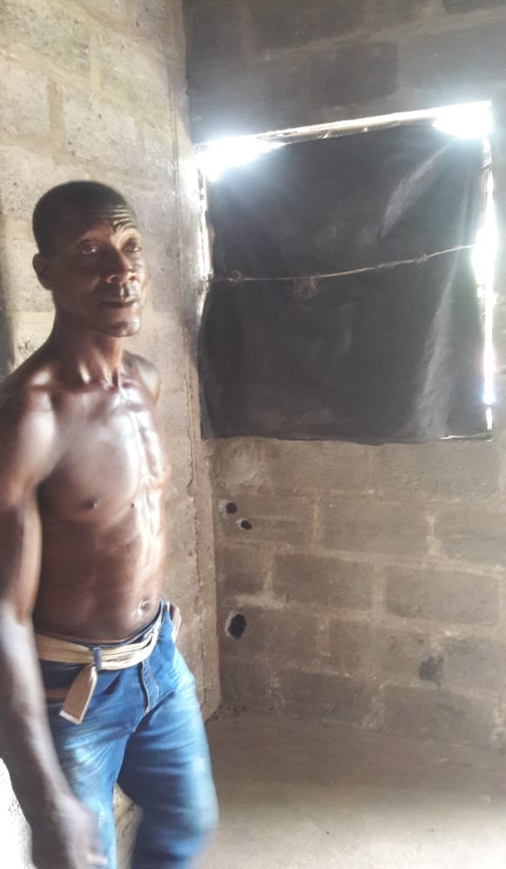
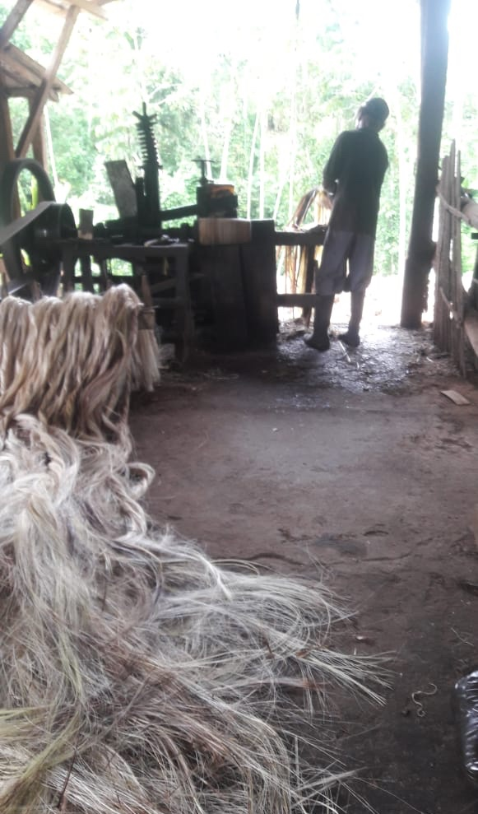
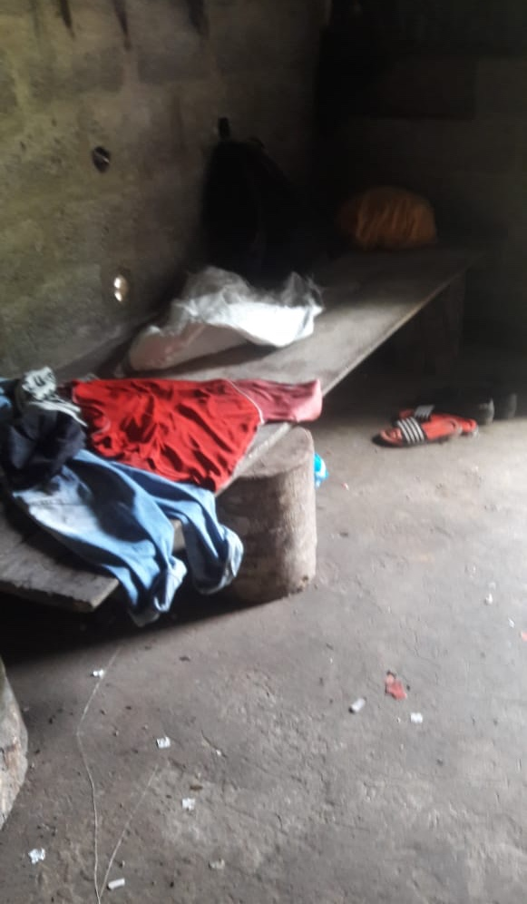

Slide 68
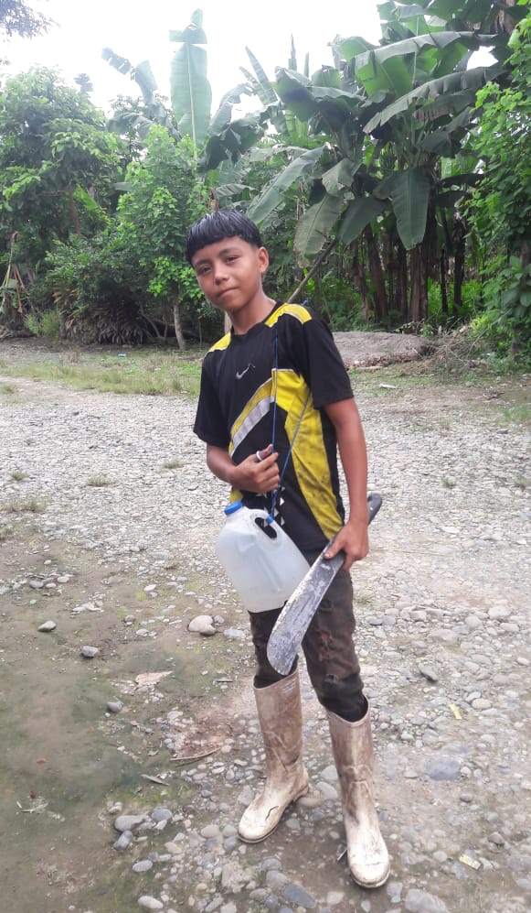
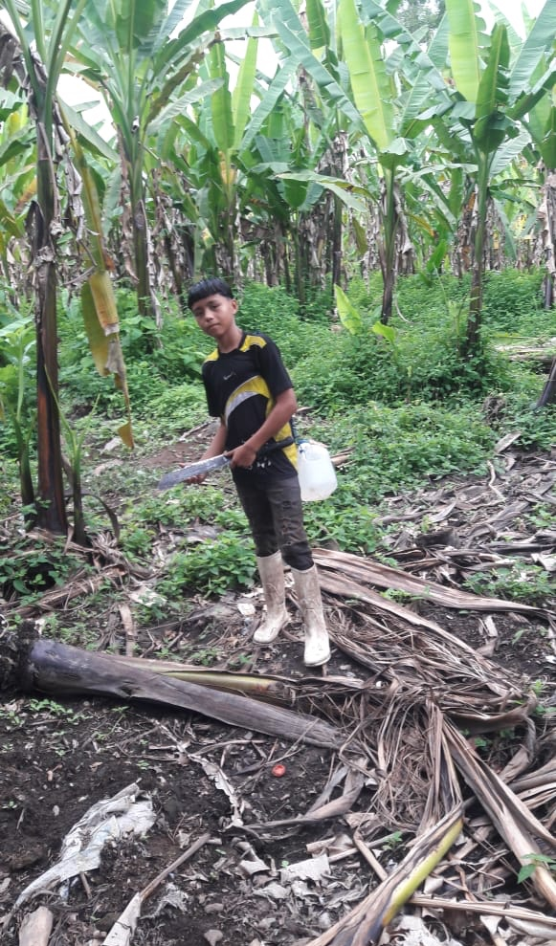


Slide 69

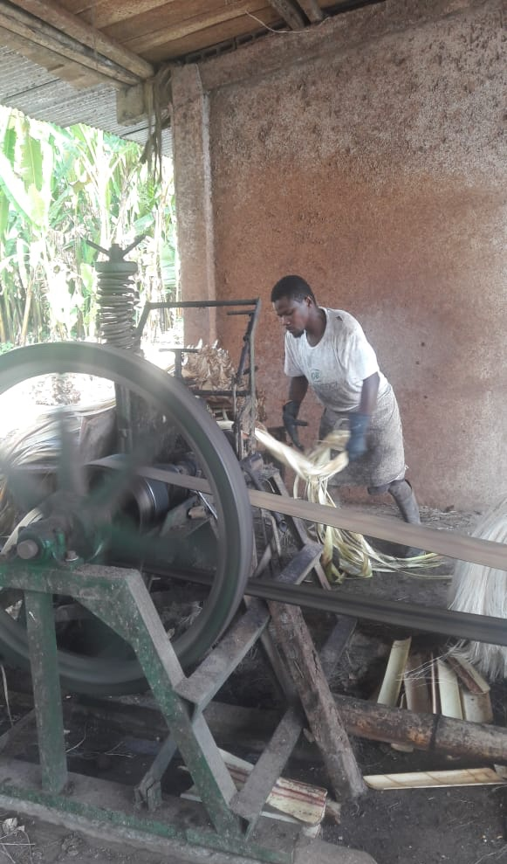
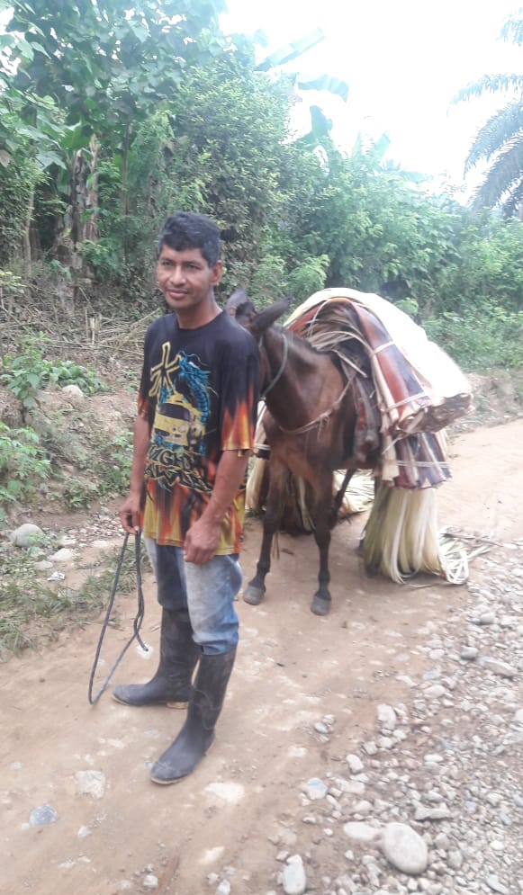

Slide 70
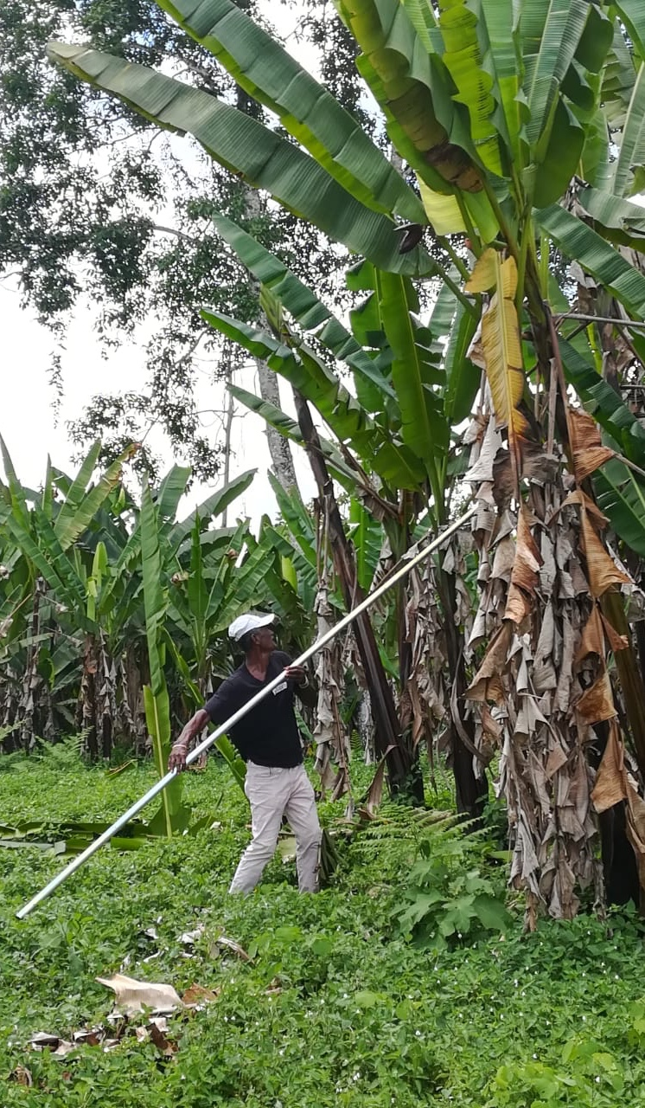
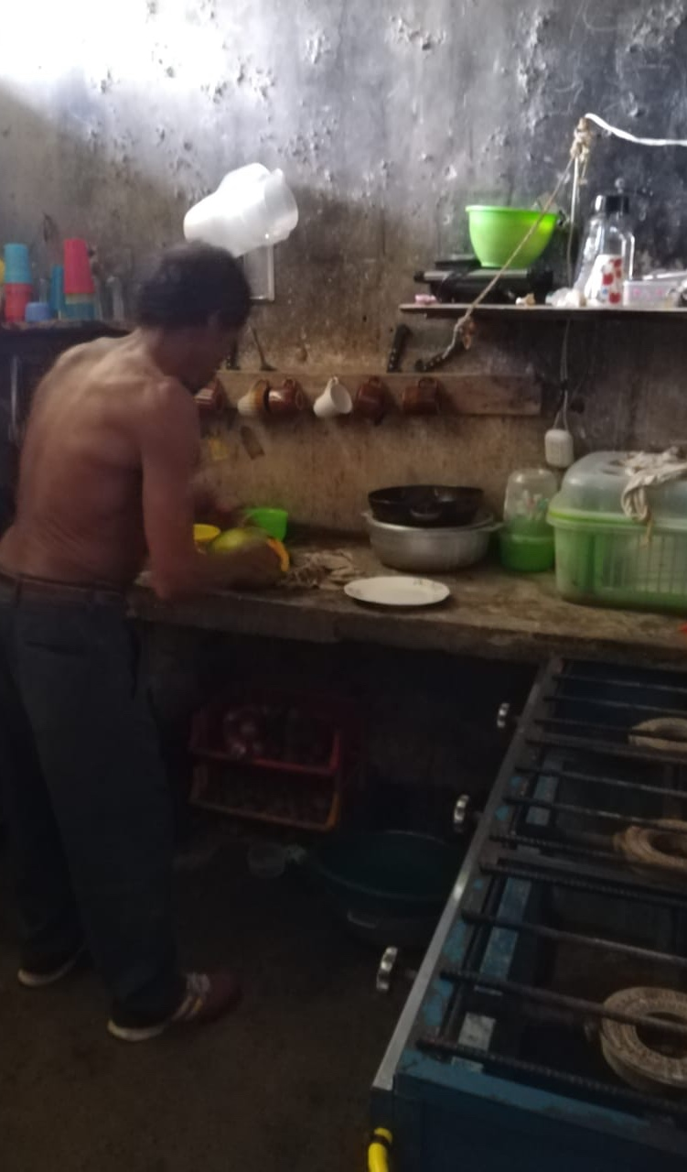
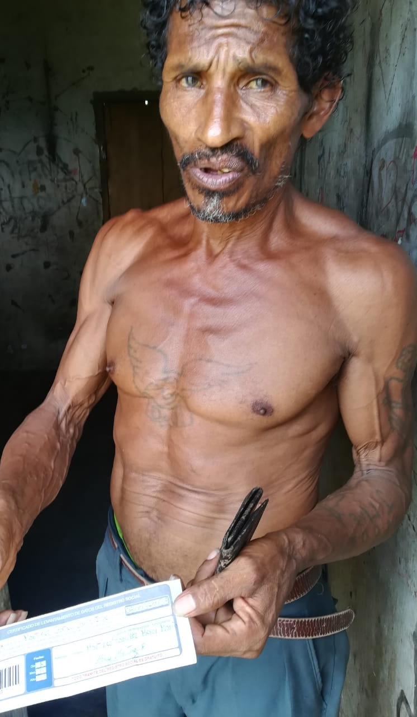

Slide 71
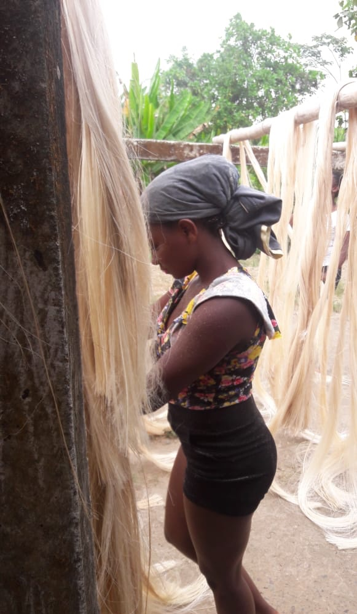
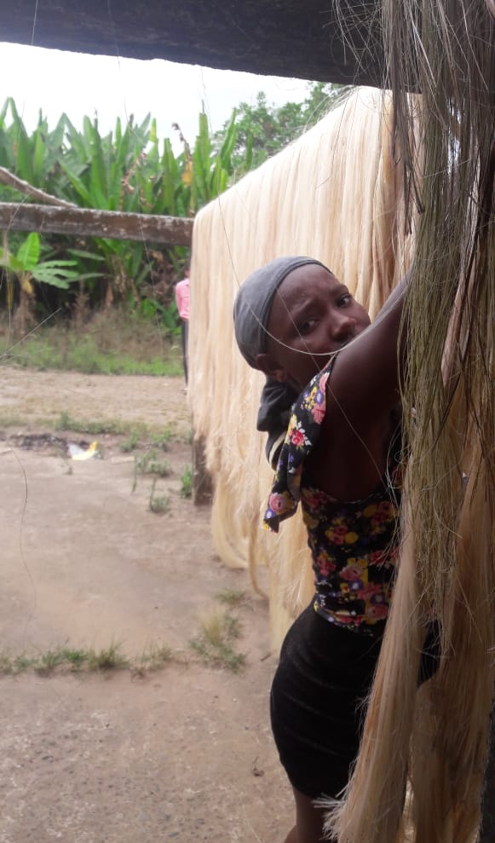
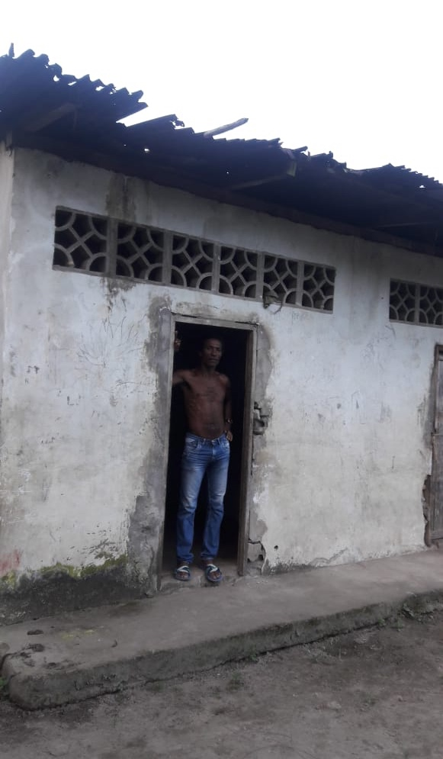

Slide 72
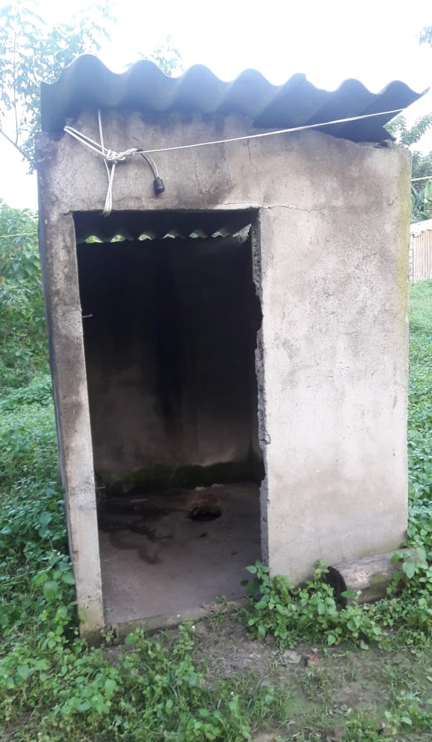
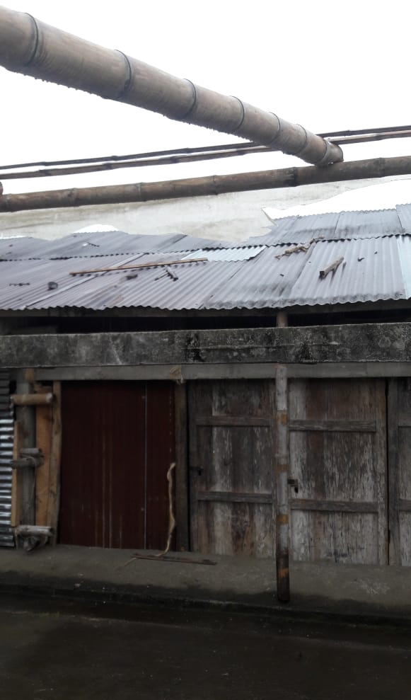
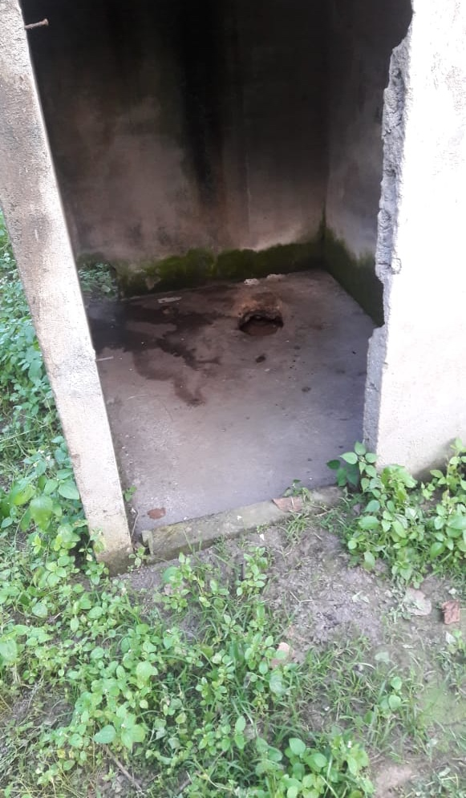

Slide 73
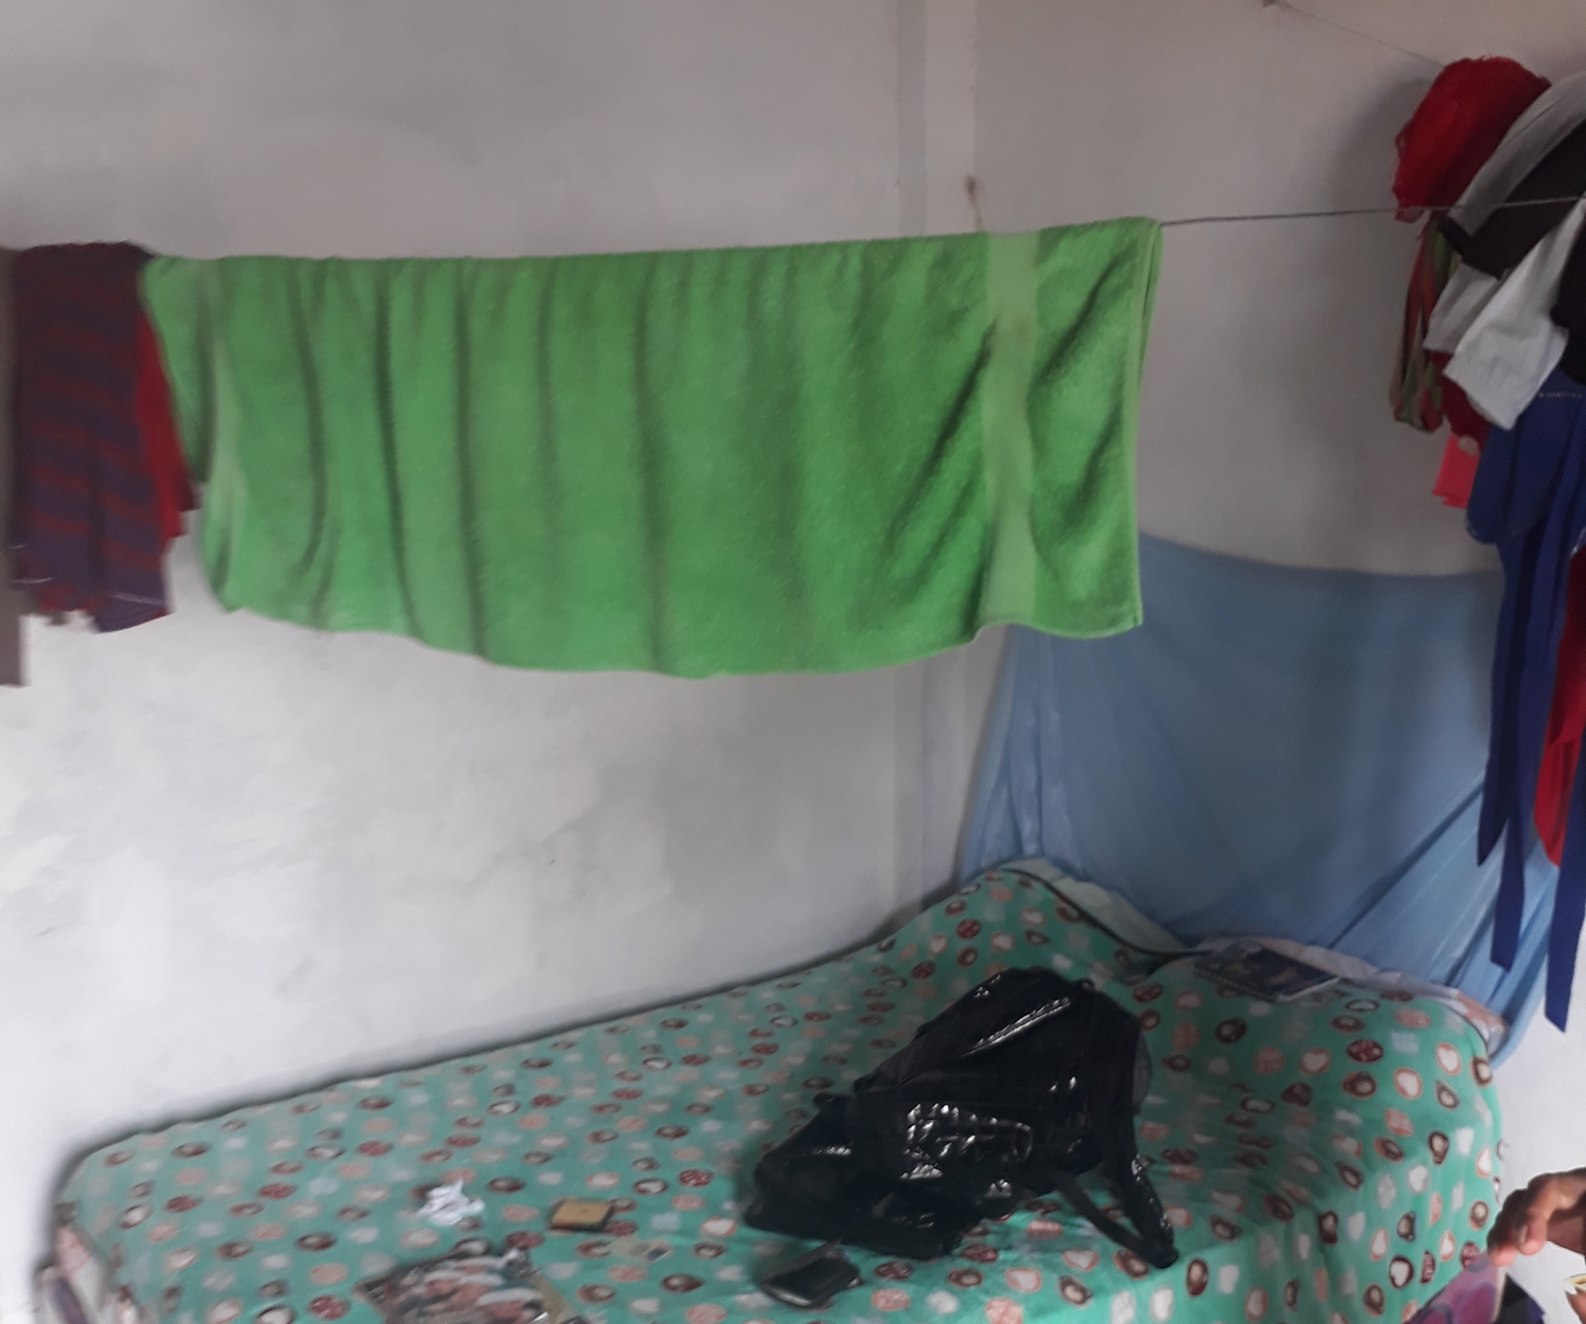
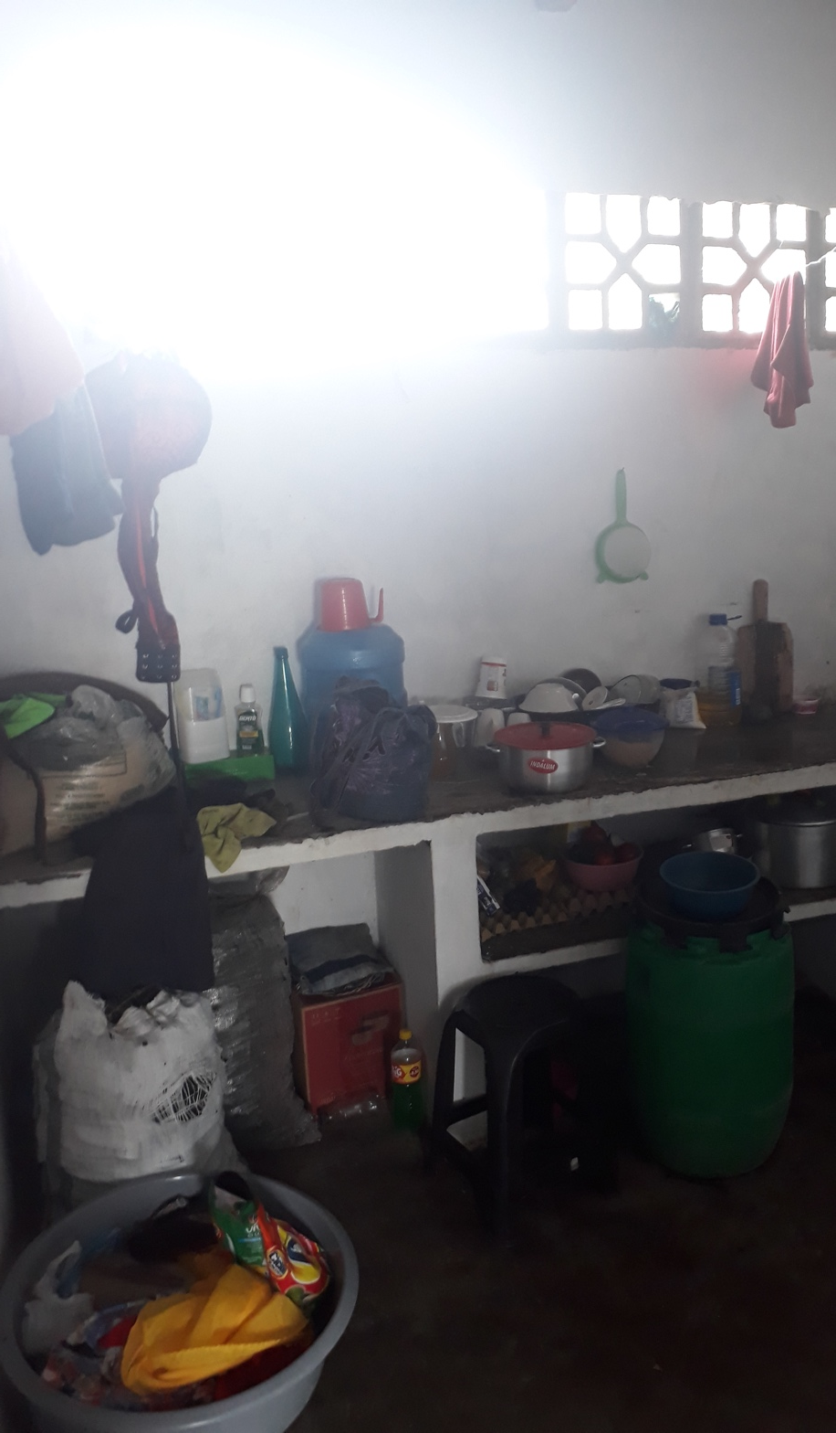

Slide 74
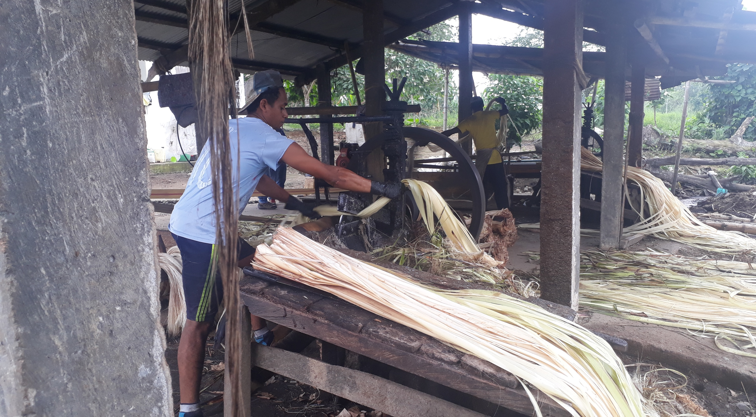

Slide 75
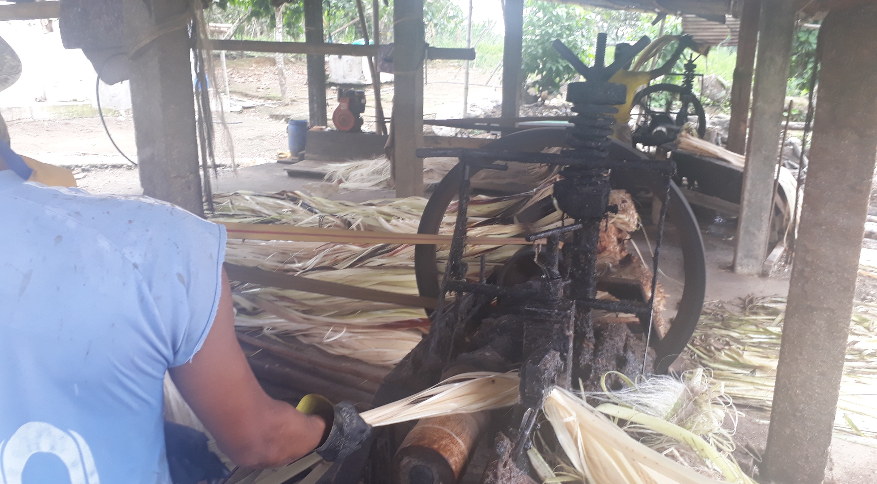

Slide 76
Judgment 1072-21-JP/24
Modern Slavery in Furukawa
Since its establishment in Ecuador, Furukawa employed several business models to cultivate abacá, with no substantial differences among them. These business models were characterized by:
  Use of intermediaries: From 1963 to 2000, those who organized work on the plantations were called “field bosses.” From 2000 to 2011, Furukawa used outsourcing companies. From 2011 to 2019, it signed lease agreements with individuals who were in the same vulnerable situation as the abacaleros.
  Exhausting workdays aimed at maximizing fiber production.
  Production quotas that abacaleros and lessees had to meet, under threat of falling into debt with the company.
  Meager income for the abacaleros due to deductions made by Furukawa. The company deducted the cost of necessary tools and, starting in 2011, the rental fee.
  Exclusive benefit to Furukawa from the abacá cultivated on its plantations.
  Women’s participation in abacá cultivation and unpaid labor within the plantations (childcare and feeding the abacaleros).

Slide 77
This practice constituted servidumbre de la gleba (bonded labor)
Abacaleros were compelled by agreements and custom to live and work on Furukawa’s lands.
The first abacaleros arrived seeking work and housing and began cultivating abacá under explicit or implicit agreements. Over the years, Furukawa used various types of agreements (such as leases between 2011 and 2019) that required cultivation of abacá on its plantations.
Custom forced generations of abacaleros to continue cultivating abacá for Furukawa, as they saw it as their only means of subsistence.
Abacaleros and lessees provided services directly to Furukawa in exchange for minimal compensation (in addition to the unpaid labor of women).
Economic exploitation and exclusive profit for Furukawa.
Furukawa exercised control over the lives of the abacaleros to the point that they had no freedom to change their condition.
Total dependence on the abacá production scheme and lack of access to alternative life options.
Use of coercive measures to prevent them from claiming their rights, rendering their consent irrelevant.
Restrictions on mobility by prohibiting vehicle access, fostering isolation and exclusive work on abacá.
The servitude disproportionately affected girls, boys, adolescents, and women.

Slide 78
The victims
The case before the Court protected the rights of 342 people
A registry found 1,244 people living on the Furukawa plantations in 2019, but many abacaleros migrated after the camps were demolished and have not been located.
The Court recognized that servidumbre de la gleba required structural measures, as it affected a larger group—namely, all abacaleros who worked on Furukawa’s plantations, even if they were not plaintiffs.

Slide 79
Modern slavery in Furukawa: Rights
Furukawa
State agencies
Furukawa failed to take any measures to ensure that the abacaleros lived and worked in dignity.
This omission violated the standard of due diligence in business and human rights, which requires companies to assess the impact of their activities and adopt prevention and remediation measures.
Furukawa violated the prohibition of slavery to the detriment of the abacaleros on its plantations, undermining their human dignity.
General harm was caused to the abacaleros and to the social fabric, as well as disproportionate impacts on women, children, adolescents, the elderly, and individuals who suffered amputations due to abacá cultivation.
No public institution took action concerning the situation on the plantations prior to 2018.
Public entities failed to fulfill their institutional duty to adopt preventive and protective measures against the servitude.
Before 2018, the Ministry of Labor and the Ministry of Health should have been aware of the situation of the abacaleros and taken action.
The measures adopted by public entities after the 2018 public denunciation by the abacaleros were insufficient.

Slide 80
Modern slavery in Furukawa: Reparations
Furukawa
State agencies
The company must pay for material and non-material damages to the 342 identified victims of servitude,
The company must pay additional compensation based on specific conditions of the victims
Public act acknowledging responsibility and offering an apology.
Creation of an inter-institutional public policy aimed at addressing and overcoming the structural causes that enabled servitude.
Public apologies
Legal reforms to prevent corporate impunity and eliminate slavery-like practices and other precarious forms of agricultural labor
The creation of a documentary on servitude and other artistic expressions to memorialize the events
The declaration of a day of remembrance for the victims of Furukawa
The broad dissemination of the judgment

Slide 81

Buen Vivir Case Law

Slide 82
For further discussion:
Does a rigid distinction between civil and political rights and economic, social, and cultural rights (ESCR) make sense?
Is it positive that ESCR are constitutionally recognized?
Is it positive that their justiciability is recognized?
Should ESCR be justiciable only through individual claims, or should collective actions also be possible?
Should ESCR be protected not only against the State but also against private actors?
Is it positive that, in addition to the right to a healthy environment, the rights of nature are recognized?
Should nature be protected as a whole, or should its elements also be protected individually?
Is there a tension between the right to a healthy environment and the rights of nature?
Why hasn't the Court addressed the right to a healthy environment and the rights of nature autonomously or separately?
How far can courts go in issuing structural remedies?
How far can courts influence public policy?
How far can courts influence legislation?
Is it democratic for courts to rule on ESCR cases?
Can people actively participate in democracy if they lack access to food, housing, water, and other ESCR?
To what extent should courts consider the feasibility of compliance with their decisions?
To what extent should courts consider budgetary limitations when ruling on ESCR cases?
Can it be counterproductive for courts to issue decisions that are impossible to implement?

